Slide 1

Chit Fund Decentralized Application: Architecture Overview
Bijesh Bajracharya
Metropolitan State University
ICS 690-01 Blockchain Technology

Slide 2
Contents
Introduction
Web 2 Architecture
Chit Fund Web 2
Blockchain Integration
Chit fund Web3
Chit fund Web3 Architecture
Front End
JSON RPC
Smart Contracts
Ethereum Virtual Machine (EVM)
Infura
Connection: Front end and smart contract
Future Implementation
Conclusion

Slide 3
Introduction
Chit-fund: Transaction between number of people in agreement who subscribe to certain sum of money by periodical installments over a period.
Borrowing scheme
Consist of organizer: bring the group together, administers activities
Compensated for contribution
Participants in the chit fund
Start and end date where participants can contribute to the chit fund

Slide 4
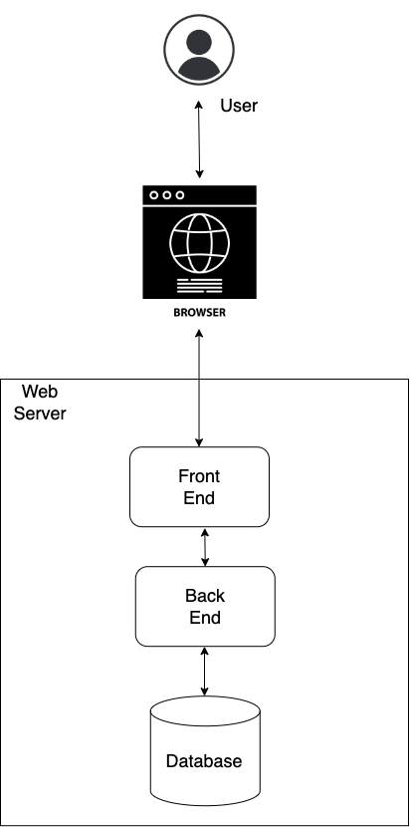
Web 2 Architecture
A blog post site: Front end used to interact with the user, exchange information.
Backend communicates with database and Frontend.
Stores data such as users, posts, comments in a database.

Slide 5
Chit Fund Web 2
Front End: Require users to register and organizers to organize the participants.
Back end: Handle the logic in running a chit fund.
Database: Store the funds
Centralized architecture concept

Slide 6
Blockchain Integration
Transparency: Every peer to peer (P2P) network has the same copy of ledger there by consisting of history of transaction.
Decentralization System: If single node fails, there are history in other nodes which makes the system much more efficient in terms of failure and third-party intervention.
Consensus: All the peers in the network has a say in making agreements and contracts. There are DAO (Decentralized Autonomous Organization) and other bodies where people can join to have their say in the agreement.
Irreversible and Immutable: It contains record of every transaction. This prevents from tampering of any data and manipulation.
Smart Contract(real-time): It has the capability of real time settlement of recorded transaction and eases governance by implementing digital agreements.

Slide 7
Chit Fund: Web3
Chit Fund Application built on top of blockchain
Decentralized state machine maintained by anonymous nodes
Front End build similar to web 2
Backend deployed to decentralized Ethereum blockchain.

Slide 8
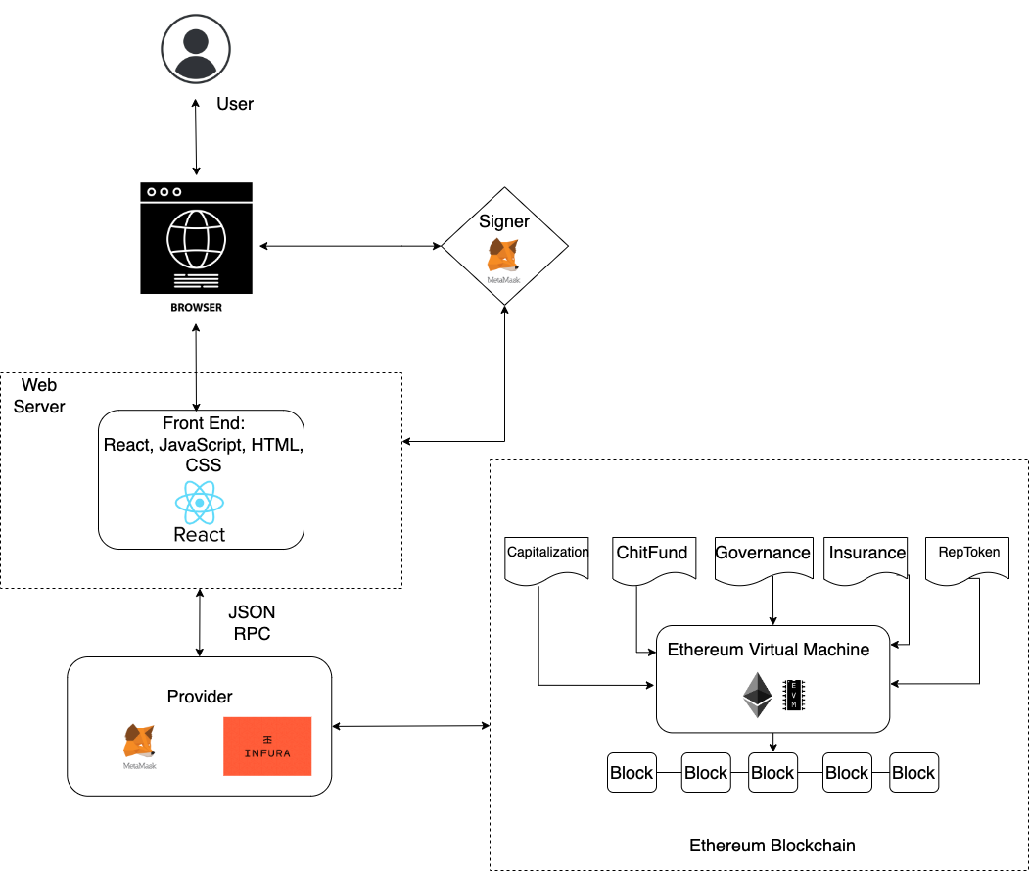
Chit Fund Web3: Architecture

Slide 9
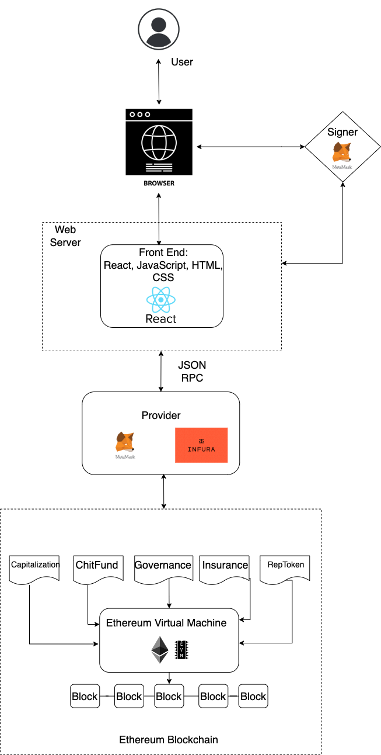
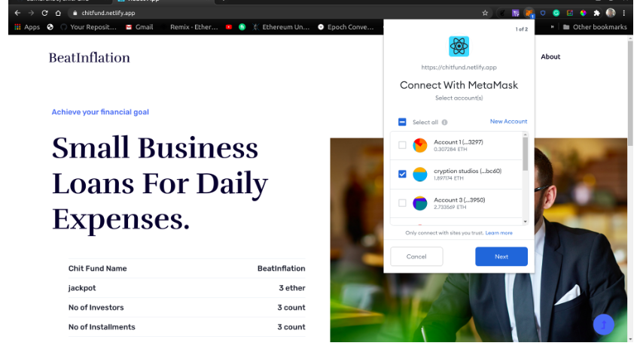
Front End
Written in React code.
Join fund, contribute to the fund, enter amount and view the Chit fund, investors and number of installments
It communicates with Meta-mask to store the crypto wallet.
The user is first signed in using the Meta-mask authentication and the account is connected to the chit fund.
Reads JSON RPC file to communicate with blockchain and smart contracts

Slide 10
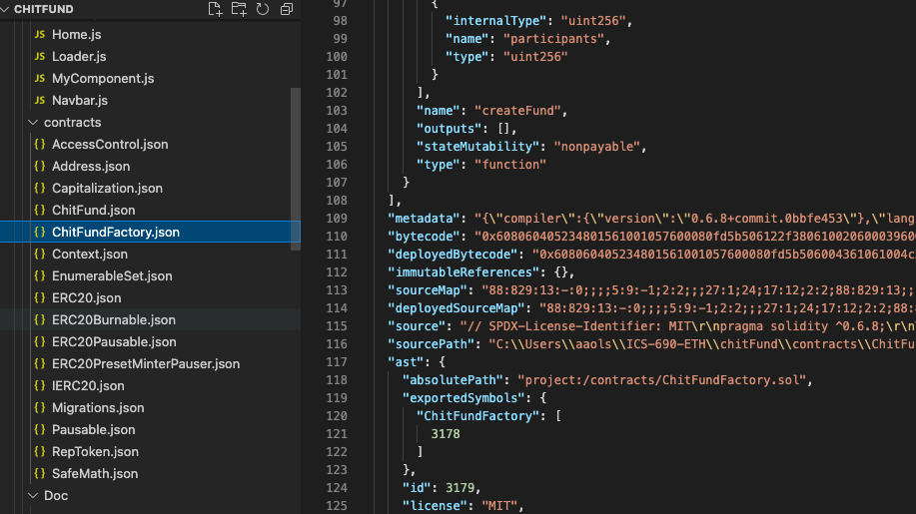
JSON RPC
Remote procedure call protocol encoded in JSON.
Data sent to the server requiring no response and answered asynchronously.
The smart contracts written in solidity compiled to JSON files using truffle.
Truffle is a development environment, testing framework and asset pipeline for blockchain which works using Ethereum Virtual Machine.
React uses these files to make a connection with the smart contract.
Infura is used to implement a JSON-RPC specification to ensure a uniform set of methods.
To write to a state in smart contract and submit the transaction to the blockchain, it needs a private key to sign. Metamask is used for this signing process.

Slide 11
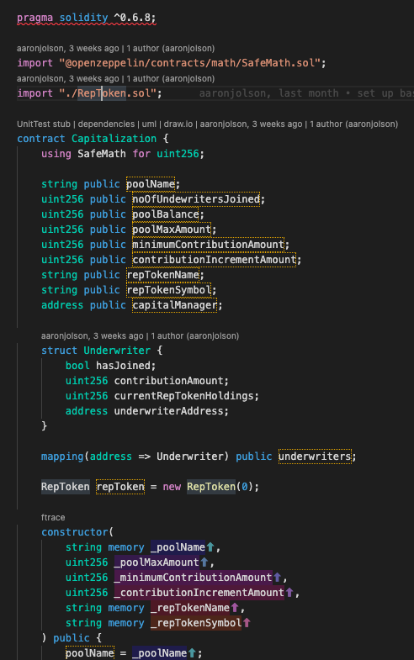
Smart Contract
Smart Contracts written in Solidity compiled using Truffle. Define the logic behind the changes in block chain
Capitalization
Underwriters contribute to the pool and awarded newly minted reputation tokens which used to underwrite users
Chit-fund
Participants can join the fund, contribute to the fund and see the number of participants and amount in the fund.
Rep-token
Contract for generating reputation tokens that acts like a voucher which a person can get by being endorsed
Insurance
Participants is insured by an underwriter with their reputation tokens. Underwriters cover for the participants in they leave the chit fund during a cycle.
Governance
DAO smart contract that oversees the governance, votes on changes to system parameters, bug patches, protocol technical enhancements, and system operations

Slide 12
Ethereum Virtual Machine (EVM)
EVM used to execute the logic defined in the smart contract
Process the state change on a globally accessible state machine.
Smart contracts compiled down to the byte code for EVM to understand.

Slide 13
Infura
Provides tools and infrastructure to deploy Blockchain application from testing to scale deployment with access to Ethereum and IPFS
Chit fund uses Infura to deploy the smart contract in Rinkeby test network (Ethereum test network)
Credentials for metamask and infura endpoints are stored in .env file which don’t get uploaded to the git
Once truffle commands are used to compile the smart contract, the JSON RPC files are generated
Smart contracts are deployed in the Rinkeby test network (Ethereum test network)

Slide 14
Connection: Front end and smart contract
Front end -> Nodes -> BlockChain
Provider: Chit fund uses Infura as a third-party service. The front end interacts with the node in the blockchain.
Metamask also stores the private key where front end needs to sign a transaction, so it also acts like a provider.

Slide 15
Future Implementation
IPFS: Distributed file system for storing and accessing data in a peer-to-peer network. It makes it easy to retrieve the data. Can be used with Infura which provides an IPFS node. Front-end application can also be hosted in IPFS
The Graph: Off-chain indexing solution for query data on Ethereum blockchain. It allows to define smart contract to an index, which event and function call to listen to, transform incoming event to entities for front end to consume. Indexing helps to query data with low latency.
Polygon: Used as transaction execution in off-chain network which stores only transaction data on-chain. This helps to scale the blockchain as we don’t have to execute every single transaction on-chain. It makes transactions faster and cheaper and still maintains communication with Ethereum Blockchain.

Slide 16
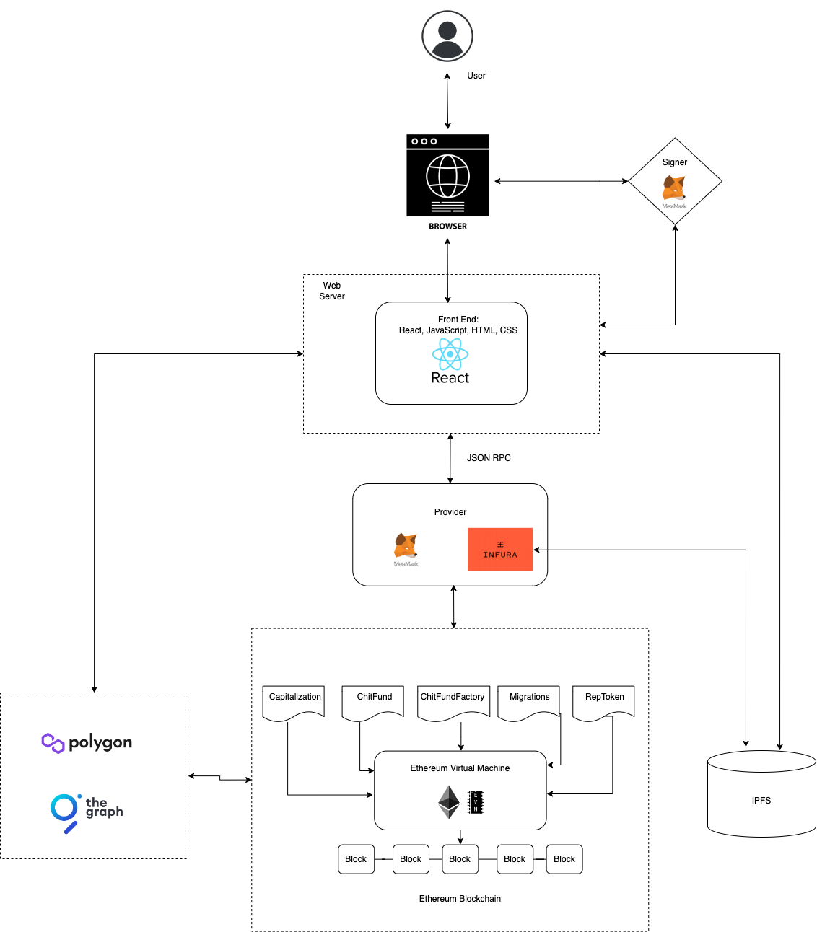

Slide 17
Conclusion and Takeaways
The Chit fund DApp architecture is comprised of different tools and languages.
With the existing and upcoming technology, this can truly work as a decentralized application on a blockchain.
As more technology is available, the architecture is bound to change according to the needs.
Testing Chit-fund
Completed CryptoZombies
Worked with React, Infura, Metamask, Solidity
Contribution: Documentation on Readme file
https://github.com/Maghribi-Foundation/chitFund/pulls?q=is%3Apr+author%3Abbajra+is%3Aclosed

